Slide 1


Microsoft Movie Analysis
Author: BEDAN CHEGE

Slide 2

Business Problem
Microsoft aims to enter the original video content market and establish a new movie studio. With limited expertise in filmmaking, the company seeks to identify the most successful movie genres at the box office. Our task is to analyze current industry trends and provide actionable insights to guide Microsoft's strategic decisions in selecting film genres for their new studio.
Notes:
Microsoft sees all the big companies creating original video content and they want to get in on the fun. They have decided to create a new movie studio, but they don’t know anything about creating movies. You are charged with exploring what types of films are currently doing the best at the box office. You must then translate those findings into actionable insights that the head of Microsoft's new movie studio can use to help decide what type of films to create.

Slide 3

Data Understanding
Research Questions:
what are the most popular movie genres?
what is the average runtime minutes of a movie?
what is the average domestic gross for a standard movie?
what is the relationship between domestic gross profit and production budget?
Notes:
For this analysis, datasets from Box Office Mojo, IMDB, and The Numbers were utilized to extract actionable insights for the head of Microsoft's new movie studio. These datasets provide comprehensive information about movies, including box office revenue, ratings, genres, runtime, and production budgets.
The IMDB datasets used in this project are divided into two main categories:
Title Basics Dataset: This dataset contains 146,144 items focusing on movie titles, genres, runtime, and release years. However, it has duplicates and missing values for runtime, which were addressed during data preparation. Title Rating Dataset: With 73,856 items, this dataset provides average ratings and the number of votes for each movie. It does not contain duplicates or missing values. Box Office Mojo is a valuable source for tracking box office revenue. The dataset used in this project includes 3,387 items and focuses on domestic gross, foreign gross, and distributor information. The primary focus of analysis was on domestic gross, which was converted from float to integer for clarity.
The Numbers dataset consists of 5,782 items and provides financial analysis for each movie, including production budgets and domestic gross. The production budget and domestic gross data initially had a '$' string value, which was converted to float and then to integer for consistency and ease of analysis.
By leveraging information from these datasets, this analysis aimed to address key questions posed in the business problem, with a focus on target variables such as genres, runtime, domestic gross, and production budget.

Slide 4
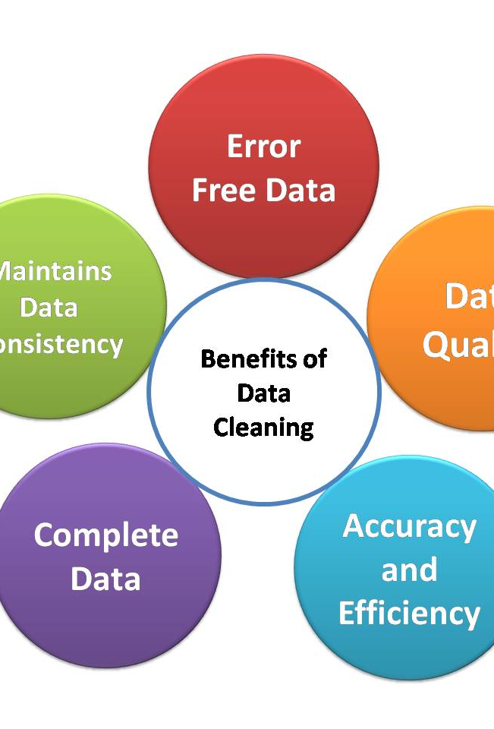
Data Cleaning & Preparation
Identified data quality issues: missing values, duplicates, incorrect data types, and outliers.
Utilized IMDB datasets: merged movie_basics and movie_ratings, dropped duplicate titles, handled missing values in runtime_minutes column by replacing them with the mean.
Converted data types in bom_movies dataset: changed domestic_gross from float to integer to avoid precision issues.
Cleaned tnmovies_budget dataset: converted production_budget, domestic_gross, and worldwide_gross from string to float, then to integer, and removed the dollar sign using Stackoverflow.
Merged cleaned datasets: combined movies_imdb with bom_movies to address research questions.
Analyzed correlation: used tnmovies_budget dataset to explore the relationship between production budget and domestic gross.
Notes:
Upon importing and reviewing the datasets, several data quality issues were identified, including missing values, duplicates, incorrect data types, and outliers for various variables relevant to the project's objectives.
* From the IMDB data set I joined movie_basics and movie_ratings since they have the information that I am interested in working on. I also dropped duplicate titles primary_title and original_title. Dropping duplicates will help avoid getting skewed or misleading result from the analysis. I also found missing values on the runtime_minute column which I replaced with the mean. I avoided dropping them to avoid losing critical information on the other columns.
* For the data set bom_movies, I first converted domestic_gross datatype from float to integer to avoid precision issues such as rounding errors.
* For the dataset tnmovies_budget i converted the columns production_budget, domestic_gross and worldwide_gross from string to float and finally to integer. I also used the Stackerflow platform to help me remove the string element "dollar sign"
After cleaning the dataset, I merged the movies_imdb dataset to the bom_movies dataset which help me answer my first three research questions.
The correlation between the production budget and domestic gross was purely done using the tnmovies_budget dataset.

Slide 5
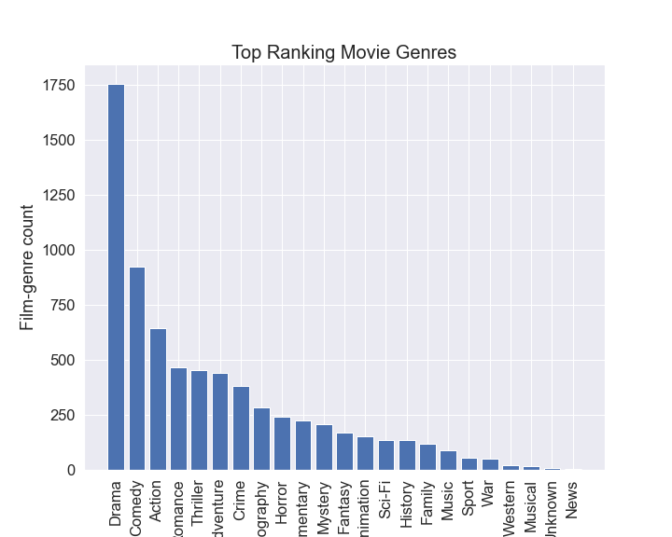
Data Analysis
Notes:
I ranked the data based on their number of votes and average ratings. By ranking them according to their ratings/votes, as seen in the highest_rated_domestic dataset, I was able to identify the top-performing genres at the box office between 2010 and 2018. To analyze these top genres effectively, I opted for a bar plot due to its ability to provide a clear visual representation of categorical data against a quantitative scale
Between 2010 and 2018, a thorough examination of genre popularity in the film industry showed people's preference. Drama films stood at the forefront, captivating audiences with their compelling narratives and relatable themes. Following closely behind, comedies consistently brought laughter to theatres, securing their place as the second most preferred genre. action-packed films, though thrilling and adrenaline-fueled, settled in third, while romance movies, with their heartwarming and often heart-wrenching tales, clinched the fourth spot. The ranking suggests a significant preference for story-driven genres, indicating a potential trend in audience desire to watch.

Slide 6
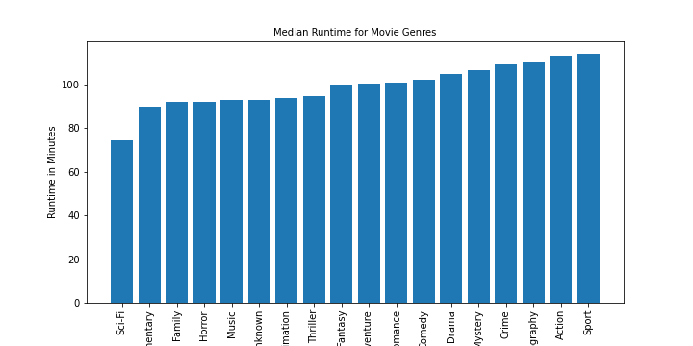
Data Analysis
Notes:
In the event that Microsoft ventures into the realm of film production and seeks to determine the optimal movie length, it could consider adopting a standard runtime, such as 107 minutes, as a conservative approach. I targeted the runtimes for each genre and then finding the average runtime required and used a bar plot to visually present it.

Slide 7
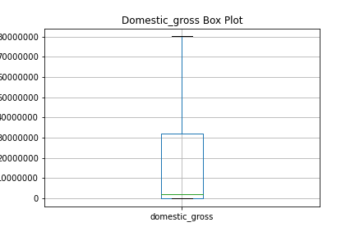
Data Analysis
Notes:
I used a boxplot to plot the visual summary of the central tendancy.
From the boxplot the average average domestic gross was 30,638,100.00

Slide 8
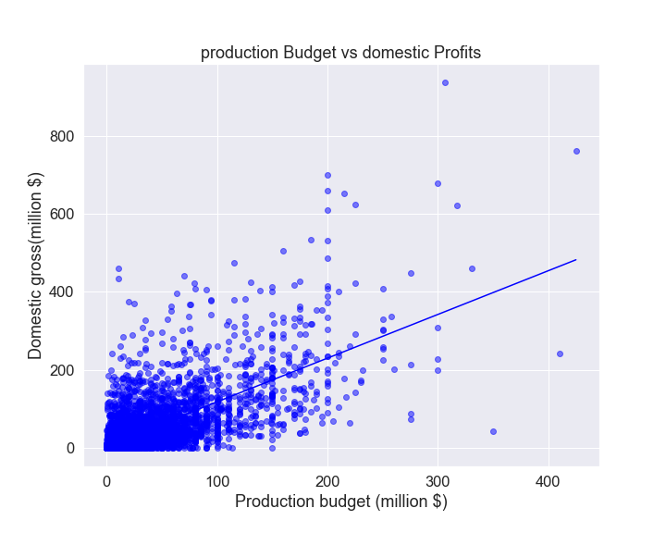
Data Analysis
Notes:
To check the relationship between domestic gross and production profits is used a scatter plot with the line of best fit.
Does this imply that the more money I put in for making a movie, the more the return?
the slope is steep and positive which is an indication of a positive correlation between production budget and domestic gross. Higher budgets appear to have higher returns as observed from the few high budgets in the scatter plot.

Slide 9

Conclusion
From the finding in movie analysis achieved from the 2010 to 2018 data it is clear that genre of the movie plays a great role in the success of a movie. drama and comedy are the leading genres in preference and revenue generation. the average runtime for a movie is 107 minutes but the length is not a direct predictor of success. However, the relationship between production budget and gross brings better return in profits.
Notes:
From the finding in movie analysis achieved from the 2010 to 2018 data it is clear that genre of the movie plays a great role in the success of a movie. drama and comedy are the leading genres in preference and revenue generation. the average runtime for a movie is 107 minutes but the length is not a direct predictor of success. However, the relationship between production budget and gross brings better return in profits.

Slide 10
Recommendation
While Drama and Comedy have demonstrated robust performance, maintaining a diverse range of movie genres is essential to cater to varying audience preferences and minimize risks. When it comes to budget allocation, it's crucial to allocate resources wisely, prioritizing areas such as story quality, casting, and post-production. Although a higher budget often correlates with greater returns, it's imperative to ensure that funds are utilized effectively to maximize impact.
To gain deeper insights into underperforming genres like romance, mystery, and music, conducting comprehensive market research is essential. Understanding the reasons behind their lackluster revenue generation can inform strategic decisions for future projects and help tailor content to better meet audience expectations.
Additionally, given that movie runtime alone does not determine financial success, strategic marketing initiatives can significantly influence a movie's performance. By implementing effective marketing strategies, filmmakers can enhance visibility, attract audiences, and ultimately contribute to the success of their projects.

